Slide 1
Solar Panel Impact on IL Home Sales
By Nick & Yasser

Slide 2
Summary
Stakeholder Information
Data Sourcing & Shape
Exploring Hypothesis’
Impact on Sale Price
Market Time: Existing Homes
Market Time: New Construction
Impact on SP:OLP Ratio
Key Takeaways
Next Steps

Slide 3
Stakeholder Information
Solar Panel Cost & Efficiency in Illinois
For residential developers and renovators/flippers in IL
Should you consider installing solar panels before selling a newly constructed or renovated home?
Average size system for single detached residence: 5kW
5kW System Avg Cost: $15,600; $11,544 (after tax credit)
Average Payback Period: 10.4yrs
Average 20 Year Energy Savings: $26,678

Slide 4
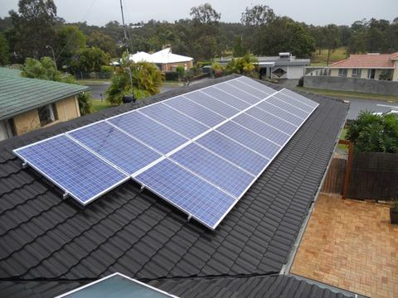
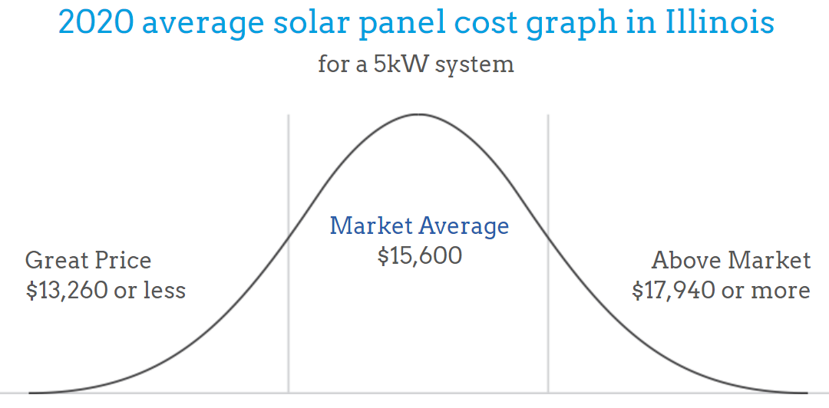
5kW Solar Panel System

Slide 5
Data Sourcing & Shape
Source: MLS MRED
National real estate database for agents and appraisers
Shape:
Population = 3055 Single Detached Homes Sold in the last 24 months
8 Features:
List Price
Sale Price
SP to LP Ratio
Transformation:
Combined Green Features with Remarks containing “solar panels” etc...
Market Time
City
Existing/New
Green Features
Remarks

Slide 6
Exploring Hypothesis’
H1: Homes w/ solar panels have a higher average sale price.
H2: Existing/renovated homes w/ solar panels sell faster.
H3: New construction homes w/ solar panels sell faster.
H4: Homes w/ solar panels close at a higher % of asking price.

Slide 7
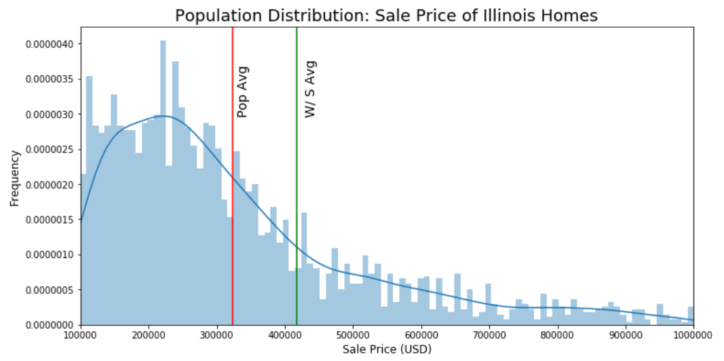
H1: Homes w/ solar panels have a higher average sale price.
Z Statistic: 3.78 P Value: 7.82e-05 Result: Homes w/ solar panels have a higher average sale price.

Slide 8
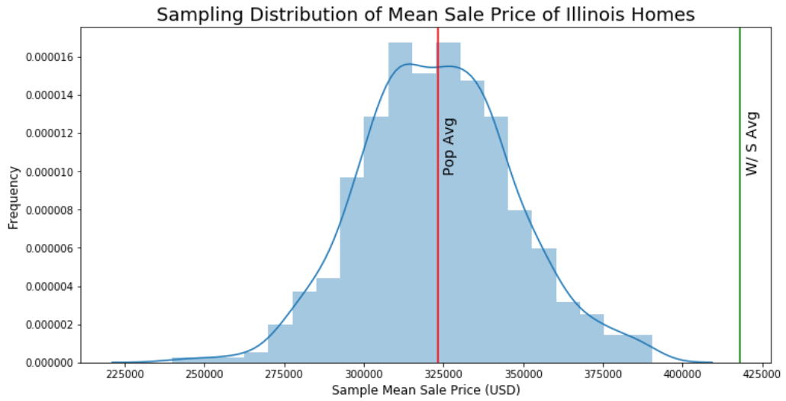
H1: Homes w/ solar panels have a higher average sale price.
Z Statistic: 3.78 P Value: 7.82e-05 Result: Homes w/ solar panels have a higher average sale price.

Slide 9
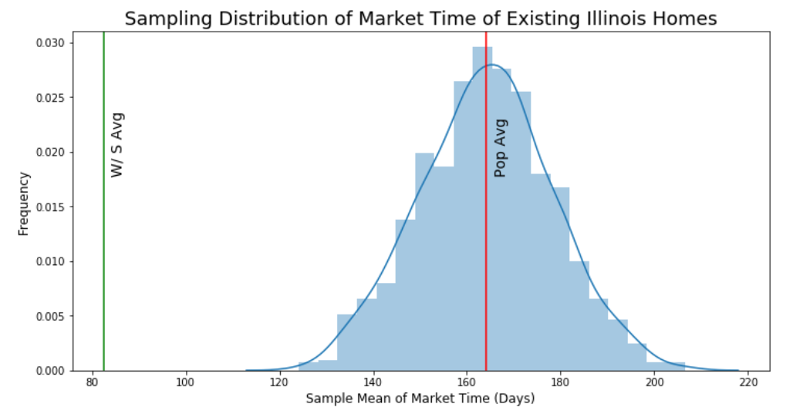
H2: Existing/renovated homes w/ solar panels sell faster.
Z Statistic: -5.86 P Value: 2.31e-09 Result: Homes w/ solar panels sell much faster.

Slide 10
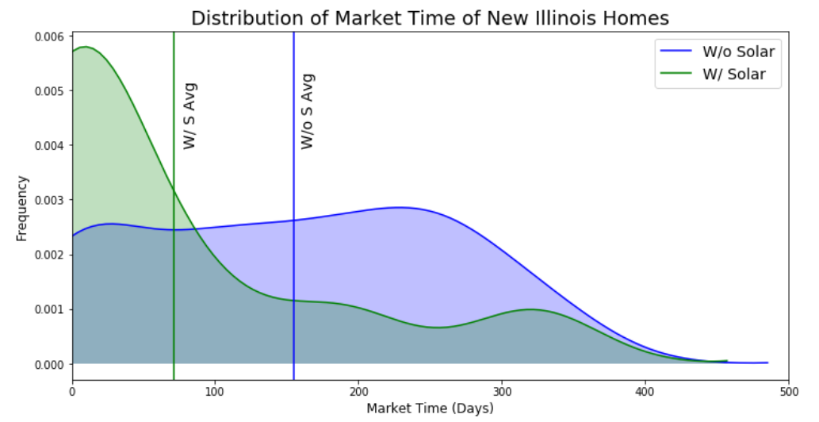
H3: New construction homes w/ solar panels sell faster.
T Statistic: -2.22 P Value: 0.02 Result: New homes w/ solar panels sell faster than without.

Slide 11
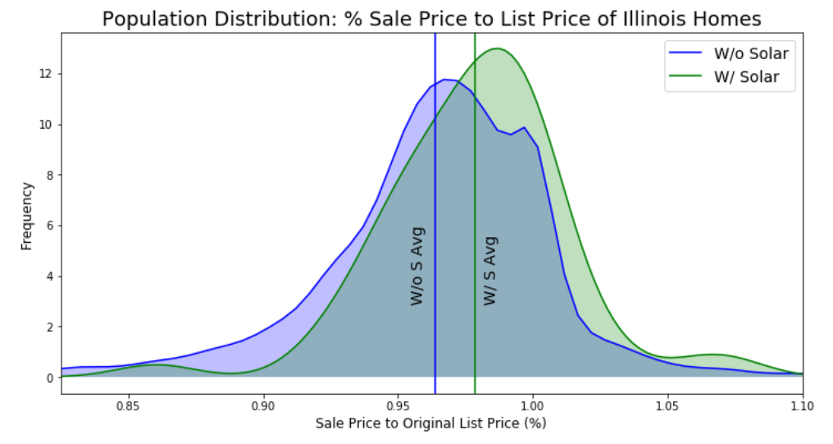
H4: Homes w/ solar panels close at a higher % of asking price.
Cohen’s D: 0.3
Effect Size: Small
Z Statistic: 2.29 P Value: 0.01 Result: Homes w/ solar panels close at a higher % of asking.

Slide 12
Key Takeaways
H1: Homes w/ solar panels have a higher average sale price, but there are too other many factors that impact home value.
H2: For flippers you can add solar panels to sell your home faster, and avoid losing profit from longer market times.
H3: For residential developers, you can add solar panels to your new homes to increase demand and lower market time.
H4: The SP:OLP ratio is higher for homes with solar panels, however, the effect size is small.

Slide 13
Possible Next Steps
More robust ANOVA or multi-variable models for testing the true impact, of solar panels as a feature, to home value.
Larger data set would increase accuracy; expand to multiple cities.
Incorporate energy costs and savings from solar panel systems into analysis.

